Slide 1
Introduction to Clinical Interpretation of Somatic Cancer Variants
Images for use in: https://griffithlab.github.io/CIVIC_SVI_Course/

Slide 2
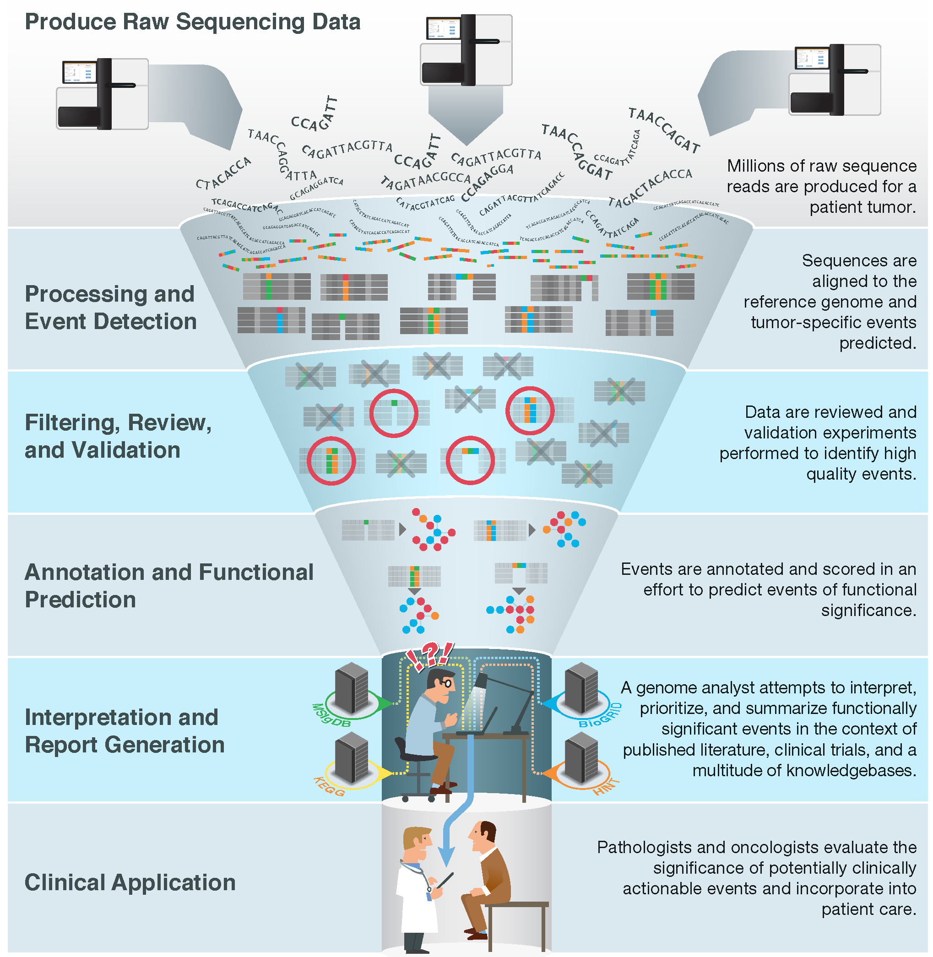
Notes:
With the advent of massively parallel sequencing, millions of raw sequence reads can no be easily produced for a patient's tumor. Largely automated pipelines now exist to process these raw data, detect various types of molecular alterations (or variants), filter and review to identify high-confidence calls, and annotate these variants for functional significance. However, a major bottleneck remains at the variant interpretation stage. Genome analysts, molecular pathologists, clinical geneticists, laboratory geneticists and others are faced with a deluge of variants of potential relevance [-@Good2014]. These variants must be manually reviewed and intersected with a vast ecosystem of knowledgebases and biomedical literature to provide current interpretation of their relevance for clinical application.

Slide 3
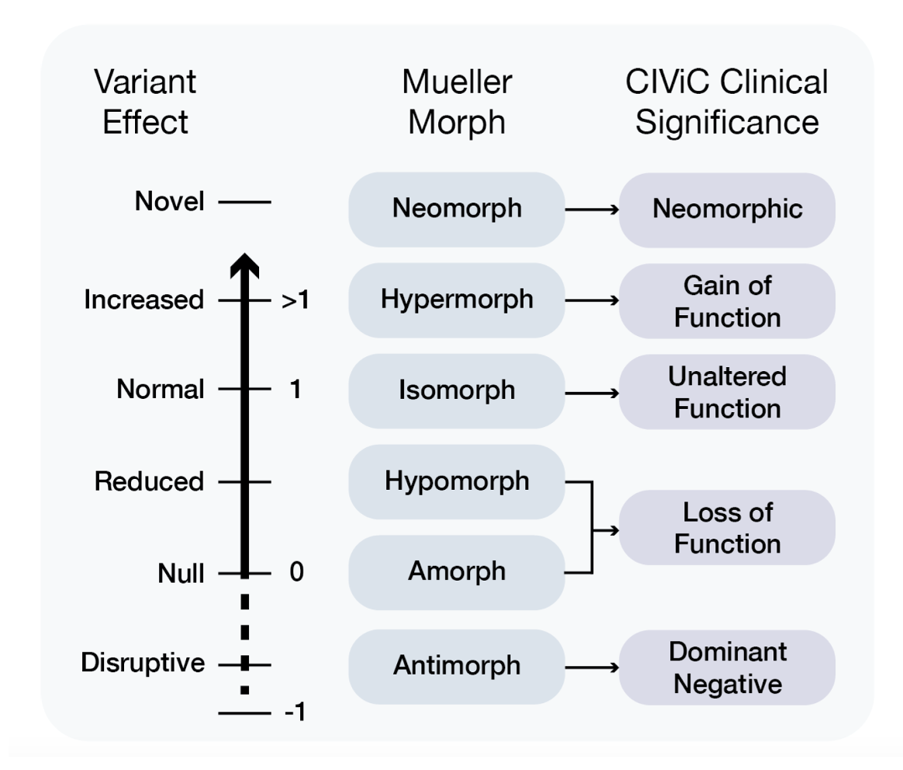

Slide 4
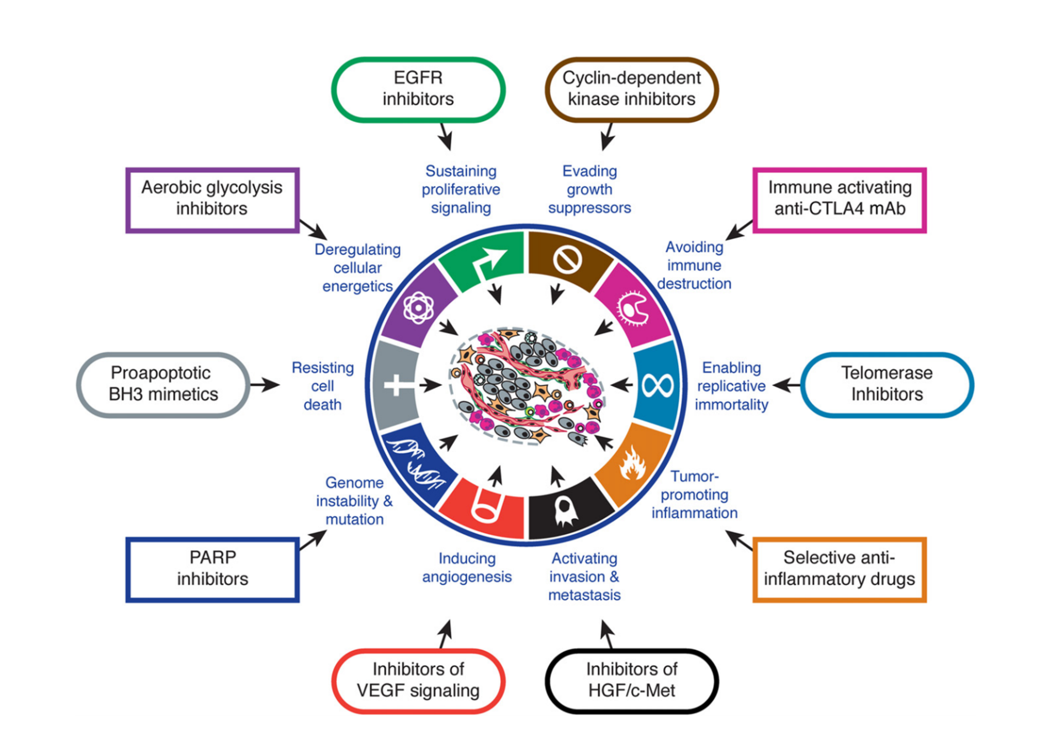

Slide 5
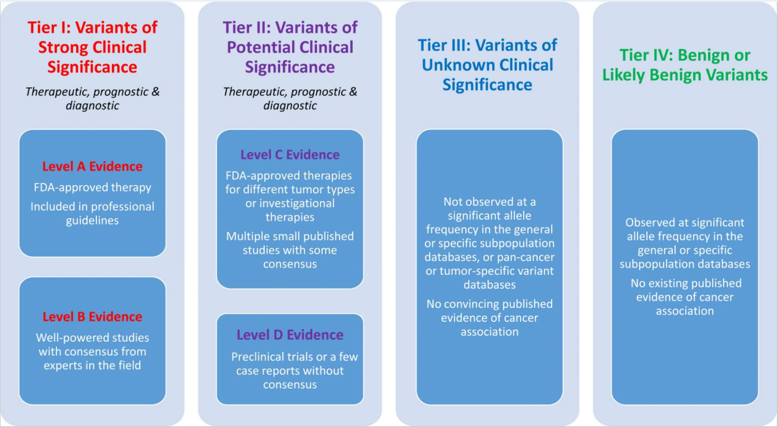
Notes:
The AMP/ASCO/CAP Standards and Guidelines classify somatic variants into four Tiers and four Levels according to their clinical significance and level of evidence

Slide 6
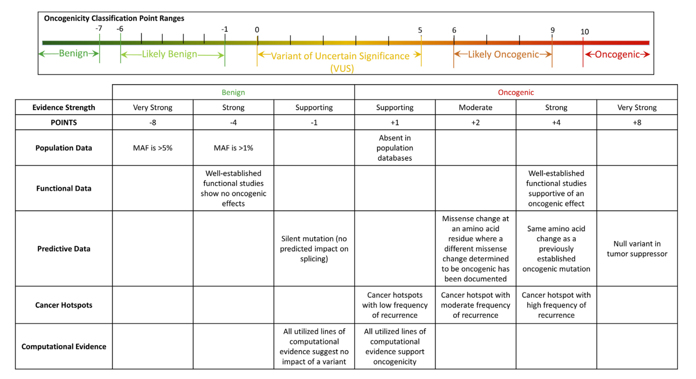

Slide 7
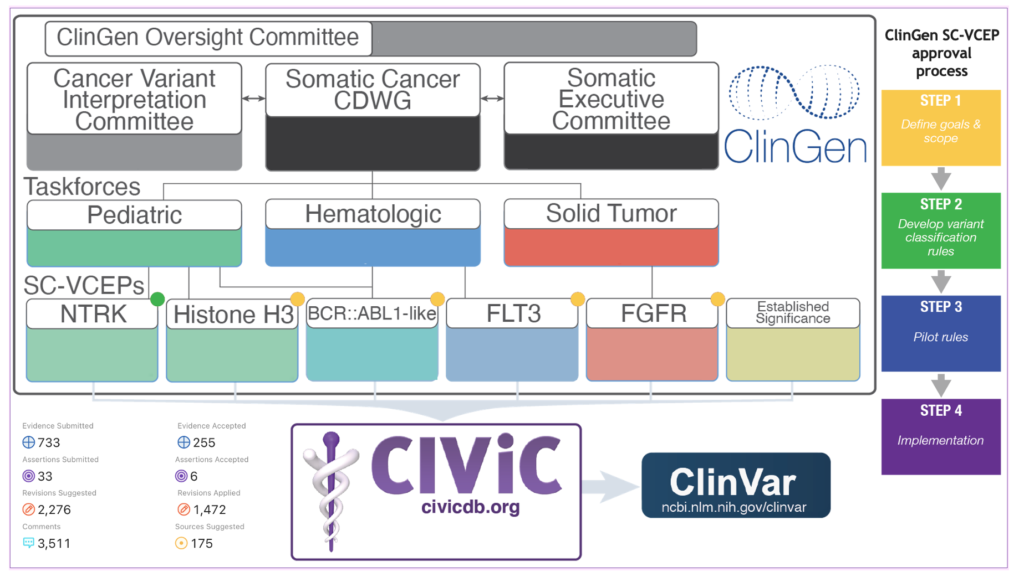

Slide 8
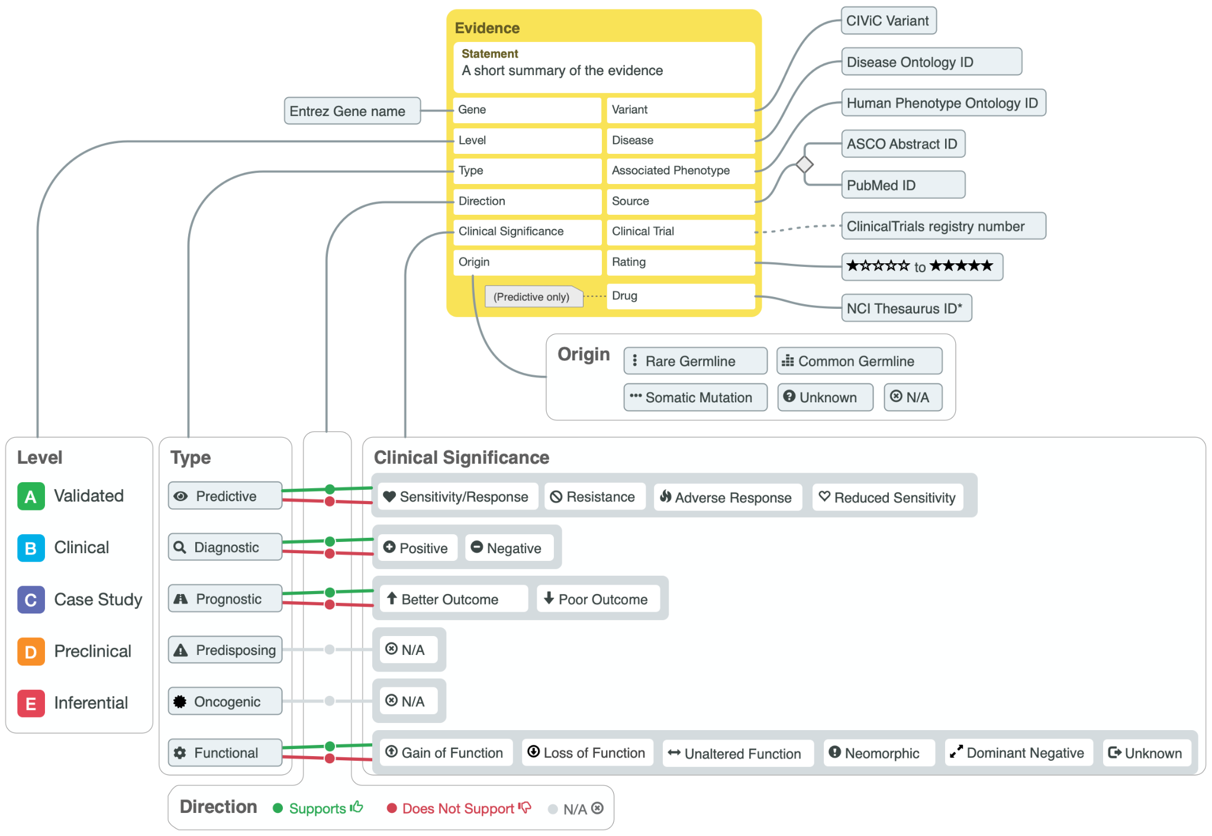
Notes:
The core element of CIViC is the evidence item (or EID) which includes an unstructured, human-readable evidence statement and multiple structured elements briefly describing a key piece of evidence from the biomedical literature related to the clinical interpretation of cancer variants. Evidence is linked to a molecular profile (variant) for a specific gene, disease, and optional phenotype. Evidence is further categorized into 6 types and 5 levels as shown.

Slide 9
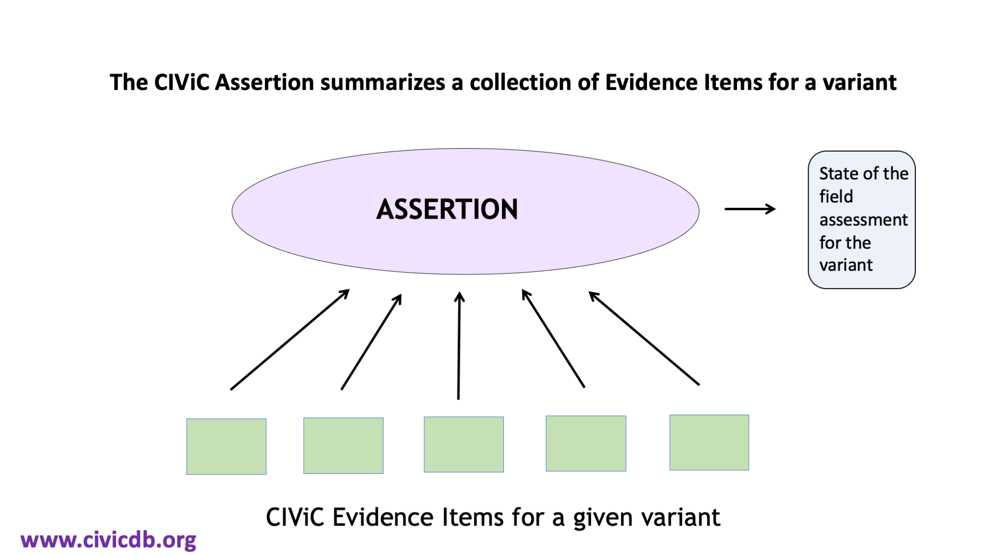

Slide 10
